Slide 1
Classification in Machine Learning

Slide 2
What it is and why it matters
Machine learning is a method of data analysis that automates analytical model building.
It is a branch of artificial intelligence based on the idea that systems can learn from data, identify patterns and make decisions with minimal human intervention.
https://www.sas.com/en_ca/insights/analytics/machine-learning.html

Slide 3
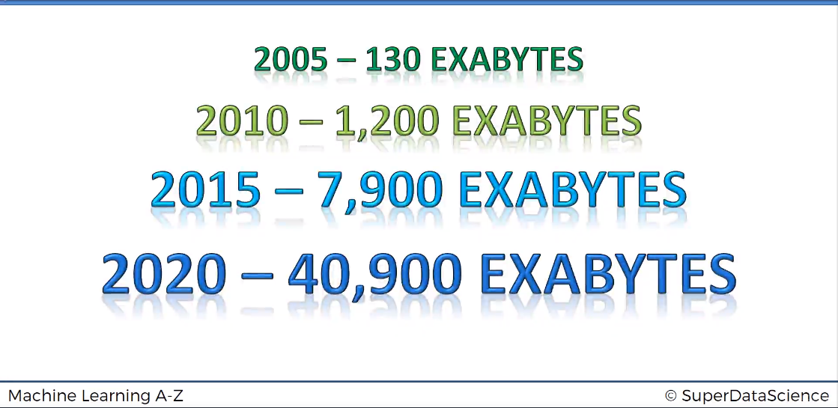
Why Machine learning is the future?
1 Exabyte=1 million terabytes

Slide 4
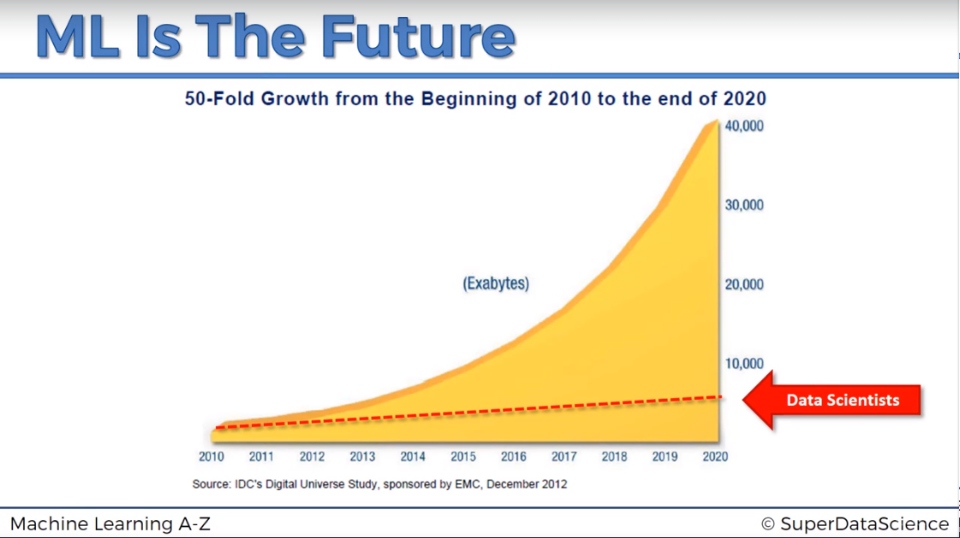
ML capacity to handle data

Slide 5
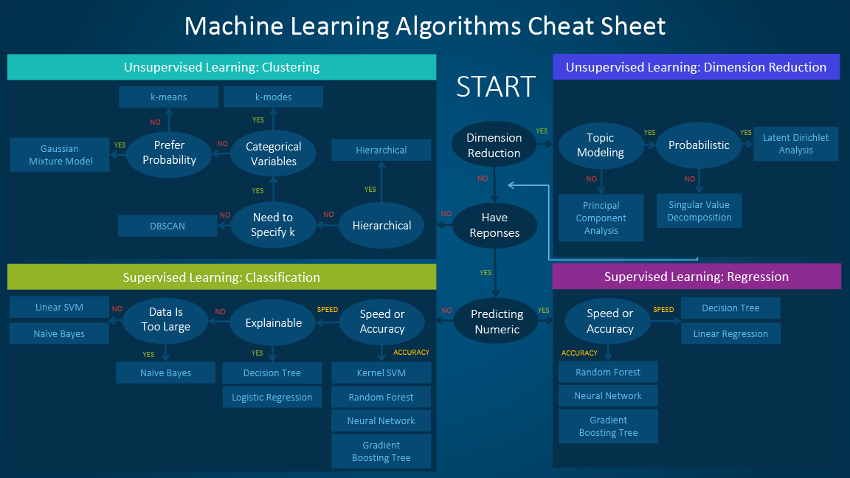
ML steps
https://blogs.sas.com/content/subconsciousmusings/files/2017/04/machine-learning-cheet-sheet.png

Slide 6
Selected database is a subset of CanCold study
data HTN;
length Patient_ID age BMI HTN 8. ;
set cancold ;
where HTN~=. and age~=. and bmi ~=.;
keep Patient_ID age BMI HTN ;
if htn=2 then htn=0;
if Diabetes=1 and EverSmokeAvgDay>0 and HeartDZ=2;
run;
N=192 cases

Slide 7

Feature Scaling and training and test sets
Obs | age | BMI | HTN
3 | 0.45383619 | -0.0966524 | 0
6 | -0.70821572 | -0.2448669 | 0
9 | 1.90640108 | -0.2448669 | 1
10 | -0.22402742 | -1.2524026 | 1
11 | -0.12718976 | -0.5070155 | 1
12 | 1.80956342 | -0.1456307 | 0
14 | 1.71272576 | -0.4110225 | 1
18 | -0.12718976 | -1.1510305 | 0
19 | -0.12718976 | 1.1096881 | 1
20 | 0.45383619 | 0.3012895 | 1
21 | 0.06648556 | -0.4370607 | 0
Obs | Patient_ID | age | BMI | HTN
1 | 100048 | 51 | 28.6689 | 1
2 | 100053 | 49 | 28.6501 | 0
3 | 100066 | 65 | 31.5617 | 0
4 | 100067 | 55 | 27.2932 | 0
5 | 100078 | 56 | 27.5482 | 0
6 | 100096 | 53 | 30.385 | 0
7 | 100182 | 55 | 30.4867 | 1
8 | 100207 | 48 | 53.7266 | 1
9 | 100262 | 80 | 30.385 | 1
10 | 100332 | 58 | 22.3863 | 1
Training set
Obs | age | BMI | HTN
1 | -1.06498962 | -0.4461631 | 1
2 | -1.26952405 | -0.4487522 | 0
4 | -0.65592076 | -0.6360733 | 0
5 | -0.55365354 | -0.6008727 | 0
7 | -0.65592076 | -0.195218 | 1
8 | -1.37179126 | 3.0130332 | 1
13 | -1.06498962 | -1.2093548 | 0
15 | 0.87808747 | -0.2966317 | 1
16 | 0.67355304 | -0.2463614 | 0
17 | -0.34911911 | 1.7740115 | 0
26 | -1.06498962 | -0.7452852 | 0
Test set
Scaled value$=\frac{x−μ}{σ}$

Slide 8
Classification algorithms
Logistic regression
k-nearest neighbors algorithm
Support vector machine
Support vector machine (kernel)
Random forest

Slide 9
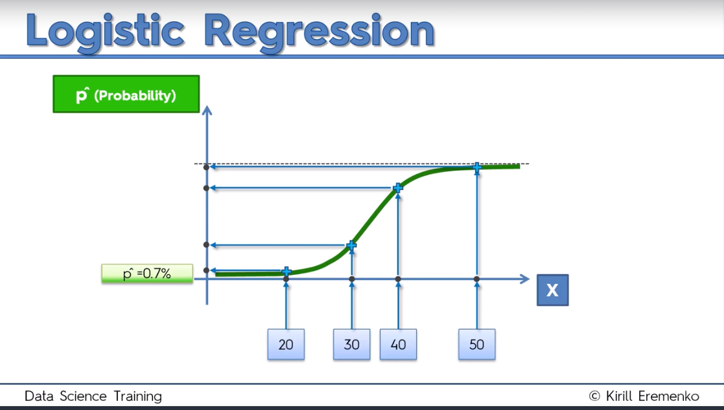
Logistic regression

Slide 10
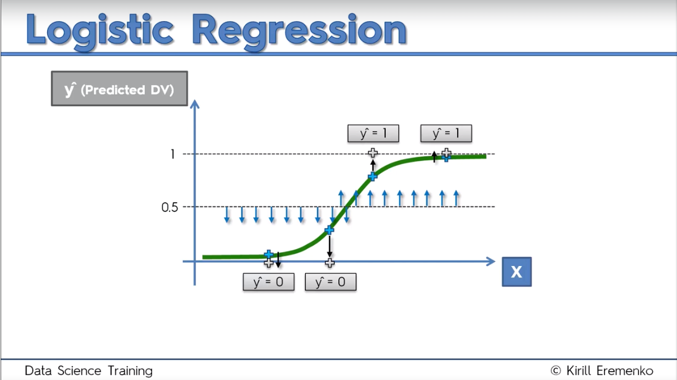
Logistic regression

Slide 11
Logistic model and predicted values in R
# Fitting Logistic Regression to the Training set
classifier = glm(formula = HTN ~ .,
family = binomial,
data = training_set)
# Predicting the Test set results
prob_pred = predict(classifier, type = 'response', newdata = test_set[-3])

Slide 12
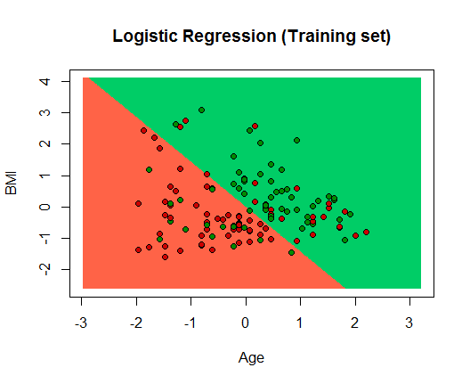
Visualising the Training set results

Slide 13
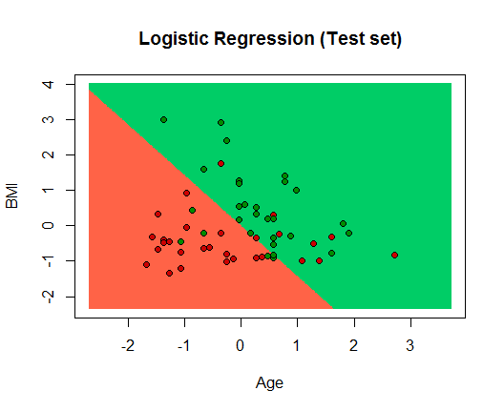
Predicted cases ( test set)

Slide 14
Confusion matrix for logistic model
Logistic regression
 |  | Predected
 |  | FALSE | TRUE
HTN | FALSE | 20 | 9
 | TRUE | 6 | 23
Error rate= 26%

Slide 15
k-nearest neighbors algorithm (KNN)
In pattern recognition, the k-nearest neighbors algorithm (k-NN) is a non-parametric method used for classification and regression. In both cases, the input consists of the k closest training examples in the feature space (Wikipedia)
Step 1:Choose the number of K of neighbors
Step2: Take the K nearest of the new data point, according to Euclidian distance
Step 3: Among these K neighbors, count the number of data points in each category
Step 4: Assign the new data point to the category where you counted the most neighbors

Slide 16
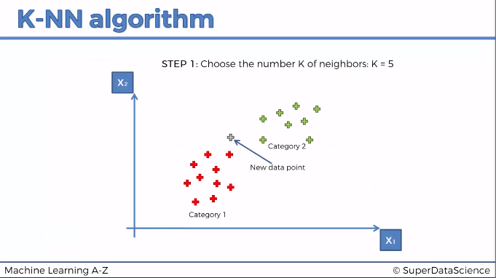

Slide 17
# Fitting K-NN to the Training set and Predicting the Test set results
library(class)
y_pred = knn(train = training_set[, -3],
test = test_set[, -3],
cl = training_set[, 3],
k = 5,
prob = TRUE)

Slide 18
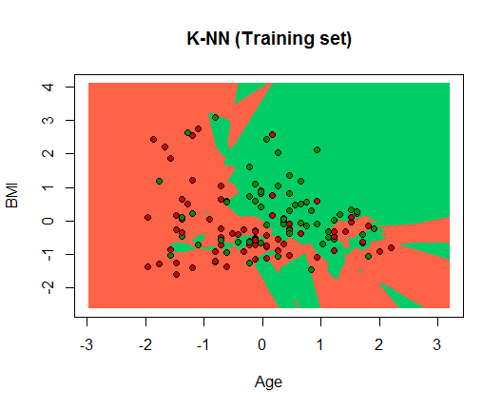
Visualising the training set results

Slide 19
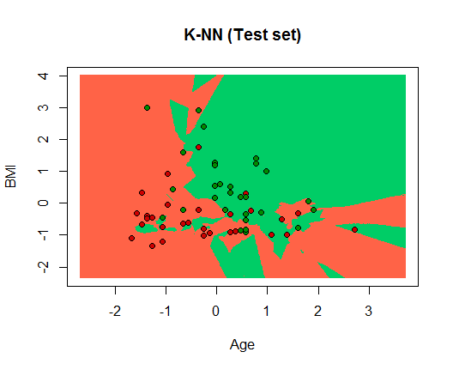
Visualising the test set results

Slide 20
Confusion matrix for KNN model
KNN
 |  | Predected
 |  | FALSE | TRUE
HTN | FALSE | 20 | 9
 | TRUE | 10 | 19
Error rate= 33%

Slide 21
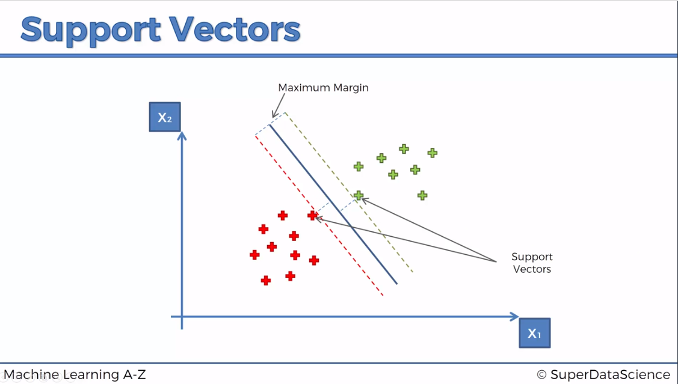
Support Vector Machine (SVM)
Is all about to find the best decision boundary to classify the groups
Maximum margin hyperplane
If we just keep two support vector points , still algorithm will not change.
Because in reality they are more then two , they have been called vectors

Slide 22
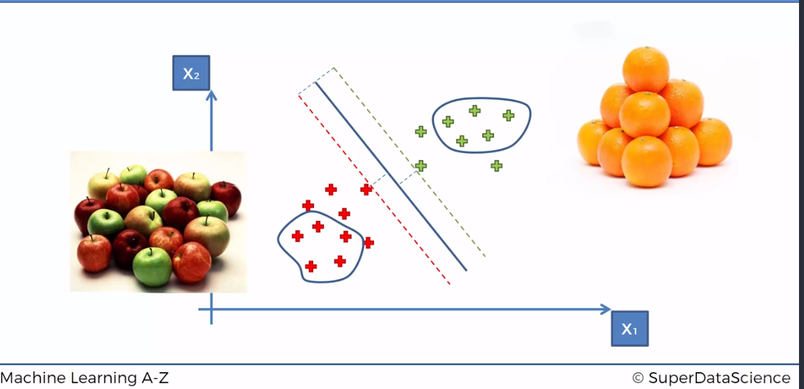
Most machine learning algorithm

Slide 23
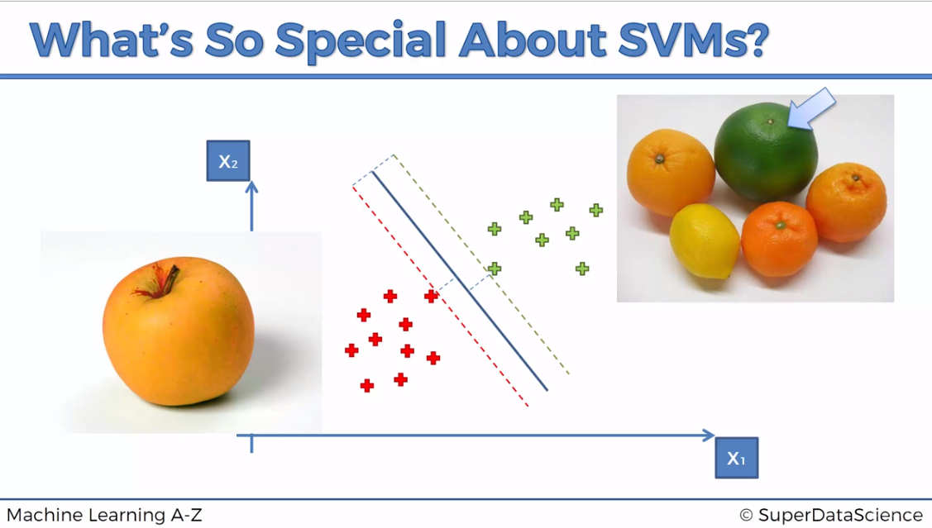

Slide 24
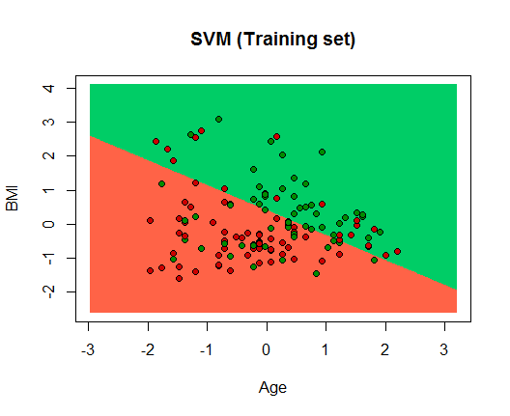
Visualising the training set results (SVM)

Slide 25
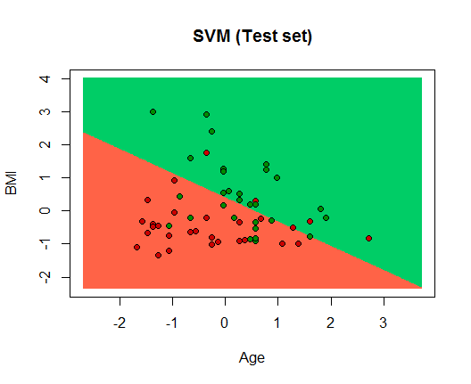
Visualising the test set results (SVM)

Slide 26
Confusion matrix for SVM model
 |  | Predected
 |  | FALSE | TRUE
HTN | FALSE | 24 | 5
 | TRUE | 12 | 17
 | Error rate= | 29%

Slide 27
Kernel SVM
What if we cannot find a boundary
Not linearly separable data

Slide 28
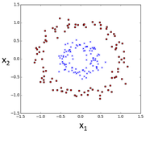
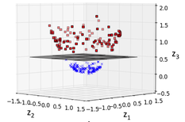
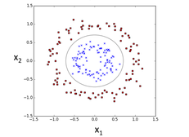

A higher-dimensional space

Slide 29
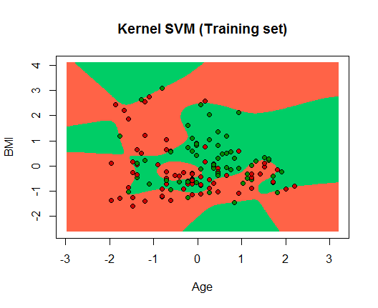
Visualising the training set results (SVM kernel)

Slide 30
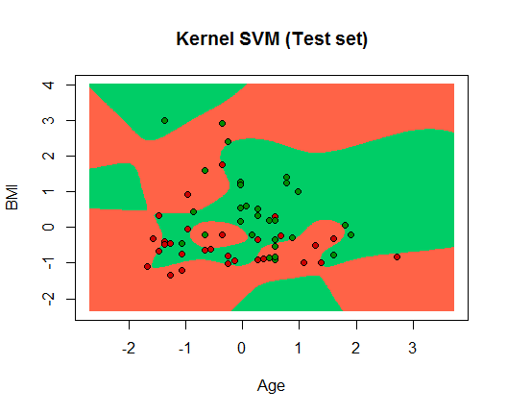
Visualising the test set results (SVM kernel)

Slide 31
Confusion matrix for SVM kernel model
 |  | Predected
 |  | FALSE | TRUE
HTN | FALSE | 13 | 16
 | TRUE | 9 | 20
 | Error rate= | 43%

Slide 32
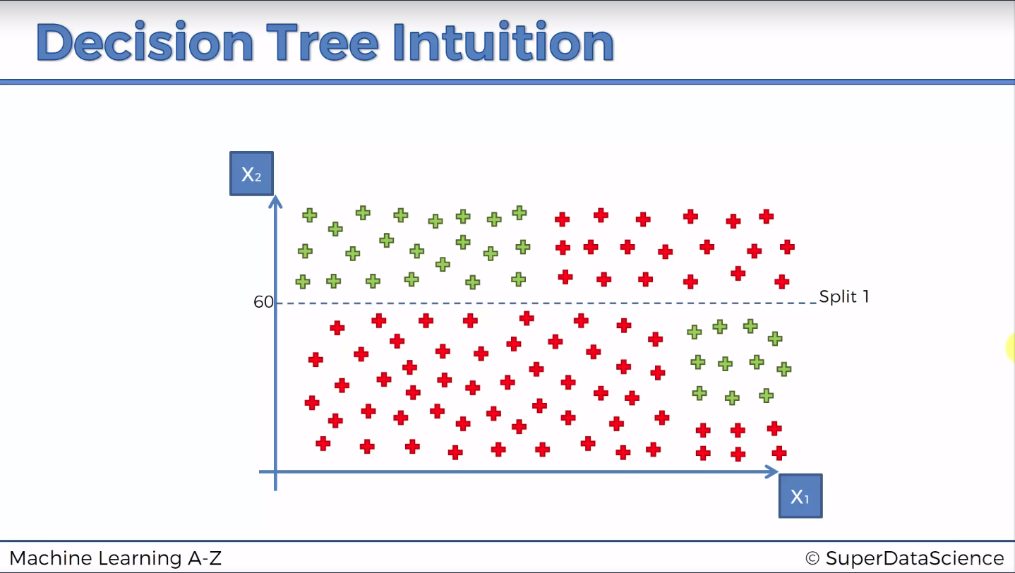
Decision Tree
Splits try to maximize numbers in each category
Or
Splits minimize the information entroopy

Slide 33
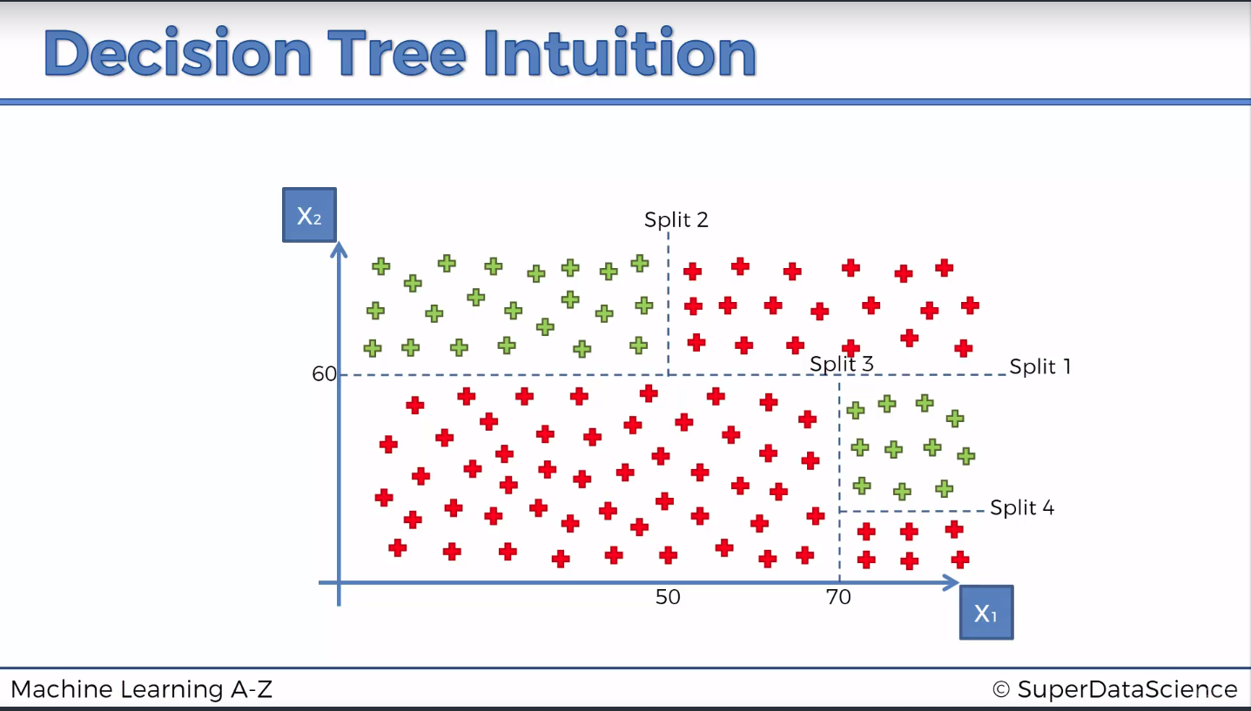
Decision tree

Slide 34
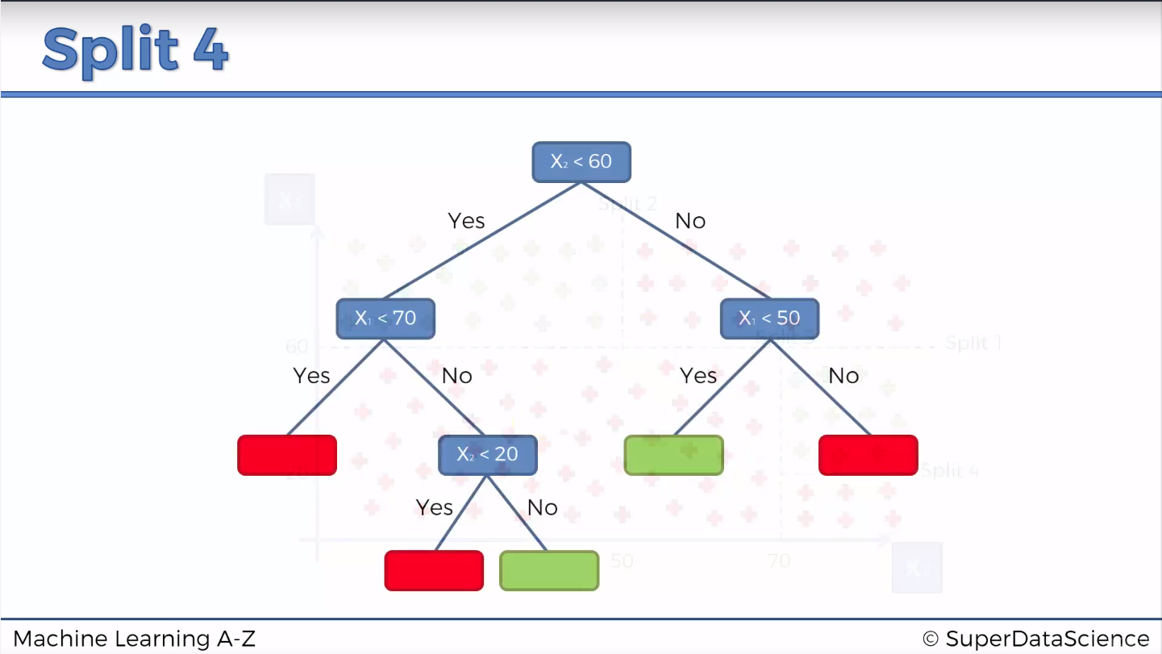
Decision tree

Slide 35
Random Forest
It is an enhanced version of decision three
It is an ensemble learning
Using multiple ML model to build a bigger ML algorithm
Pick K data points
Build DT for each data points
Repeat Step 1 and 2
Assign the data point to the category that win the majority vote
Microsoft Kinect motion detector uses RF
https://www.microsoft.com/en-us/research/wp-content/uploads/2016/02/BodyPartRecognition.pdf

Slide 36
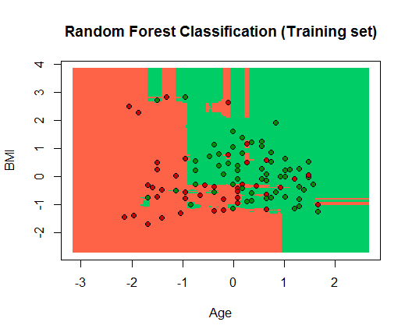
Visualising the training set results (RF)

Slide 37
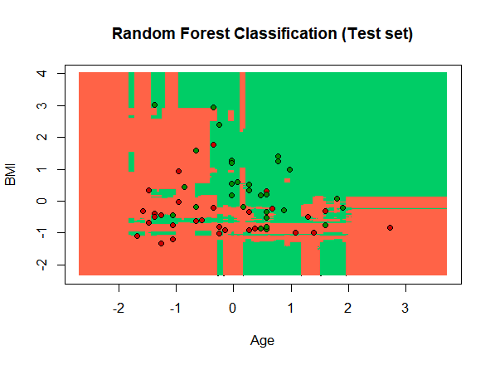
Visualising the test set results (RF)

Slide 38
Confusion matrix for RF model
 |  | Predected
 |  | FALSE | TRUE
HTN | FALSE | 21 | 8
 | TRUE | 10 | 19
 | Error rate= | 31%

